Slide 1
Cameron Veterans
Middle School
2016-2017

Slide 2
CVMS Goals
Academics
Financial
Climate
Communication
Notes:
1 minute
Collins

Slide 3
Academics
Acuity for:
6-8 ELA
6-8 Math
8 Science
Notes:
Jano and Fisher
District Objective:
The Cameron R‐1 School District will be “On Track” in all testable grade level areas given by the State of Missouri. (see #1 and #2)
90% of students will attend school 90% of the time at all levels. (see #3)
BOE Approved Strategy: Develop and utilize district assessments in all content areas
We are taking the readiness portion (A, B, and C...these do not adjust to student’s learning level).
This data will help us measure progress of MLS

Slide 4
Dates
Notes:
Laura

Slide 5
Dragon Data
Map Data Handout
Notes:
Michael

Slide 6
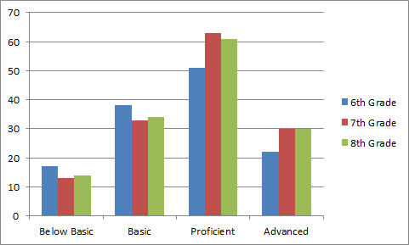
ELA
Notes:
Michael

Slide 7
Compared to State
Grade Level | State Average (from 2015) | CMS 2015 (Grades 5-8) | CVMS 2016 | State Average (from 2016)
6 | 55 | 65 | 57 | 58
7 | 57.3 | 73.8 | 67 | 58
8 | 57.6 | 72.1 | 63 | 52
Source for state information: http://dese.mo.gov/communications/news-releases/statewide-2016-map-results-released
Notes:
based off of top two percents combined (p and a) This information plus APR data will be used to set building goals for content areas.

Slide 8
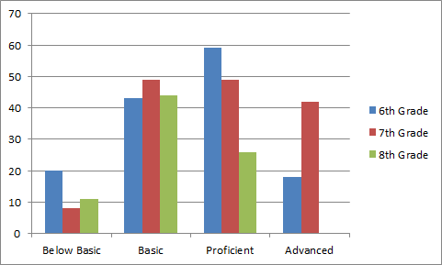
Math
Notes:
Michael

Slide 9
Compared to State
Grade Level | State Average (2015) | CMS 2015(Grades 6-8) | CVMS 2016 | State Average (from 2016)
6 | 38.1 | 43 | 60 | 43
7 | 35.3 | 55.2 | 61 | 42
8 | 28.3 | 33.3 (98.3 A1) | 32 (does NOT include A1...A1-98) | 40 (does include A1)
Source for state information: http://dese.mo.gov/communications/news-releases/statewide-2016-map-results-released
Notes:
based off of top two percents combined (p and a)

Slide 10
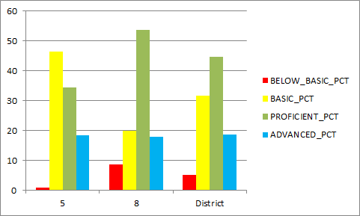
Science
Notes:
Michael

Slide 11
Compared to State
Grade Level | State Average 2015 | CMS 2015 (Grades 5-8) | CVMS 2016 | State Average (from 2016)
5 | 47 | 52.8 | (42) | 49
8 | 48.9 | 71.4 | 63 | 48
Source for state information: http://dese.mo.gov/communications/news-releases/statewide-2016-map-results-released
Notes:
based off of top two percents combined (p and a), we will use this data and acuity data to determine our goals for this year. doesn’t show basic or below basic - we focus on moving these students to proficient and advanced.

Slide 12
Curriculum Alignment and Common Grading
NWRPDC trainers facilitate the process of curriculum work
Monthly meetings for vertical alignment
Weekly meetings for horizontal alignment
Notes:
Laura
Curriculum is a living document. It will never be “finished”. RPDC resources help us to stay aligned with what is expected from DESE. They also help us to set a goal and guide us through the steps of achieving that goal.

Slide 13
Common Grading
Formative Assessment and Standards Based Grading by Robert Marzano
Weekly study and discussion
Notes:
Laura

Slide 14
4 point Scale | % | Grade | Level | Description | Ability
4 3.75 | 100% 98% | A A | Advanced | “I know it better than my teacher expected me to learn it” Met learning goal and went above and beyond | Utilization Inferences
3.5 3.25 | 96% 92% | A A- |  | Met learning goal without errors & without help. Showed partial evidence of a deeper understanding.
3 | 89% | B+ | Proficient | “I know it just the way my teacher taught it” Met learning goal without any errors | Analysis Application
2.75 | 86% | B |  | Did not meet entire learning goal due to a few minor errors.
2.5 | 82% | B- |  | Did not meet entire learning goal due to several minor errors
2.25 2 | 79% 74% | C+ C | Progressing | “I know some of the simpler stuff, but struggle with the more difficult problems” Student requires help to meet learning goals and continues to make multiple errors. | Comprehension
1.75 1.5 | 69% 65% | D+ D | Novice | “With some help, I can do the simpler stuff” Student demonstrates a minimal understanding of basic concepts | Retrieval Recall
1.25 1 | 62% 59% | D- F |  | Even with help, student does not understand the basic concepts.
Incomplete |  | F |  | Not Observed
Notes:
Laura
We will be revisiting this cross-walk. Teacher input will be used via the SRG Team

Slide 15
Attendance
A focus will be place on school attendance this year.
-Weekly reports from PowerSchool, attendance is tracked via a spreadsheet, students with low attendance meet with Assistant Principal (counselor, parent and/or SRO, if needed).
-Students that drop below 90% are addressed with the juvenile officer.
-Incentives are done monthly and quarterly.
Notes:
ATTENDANCE INFO GOES HERE-Hadley this is all you
I will talk about how this is one of my “administrator goals” this year

Slide 16
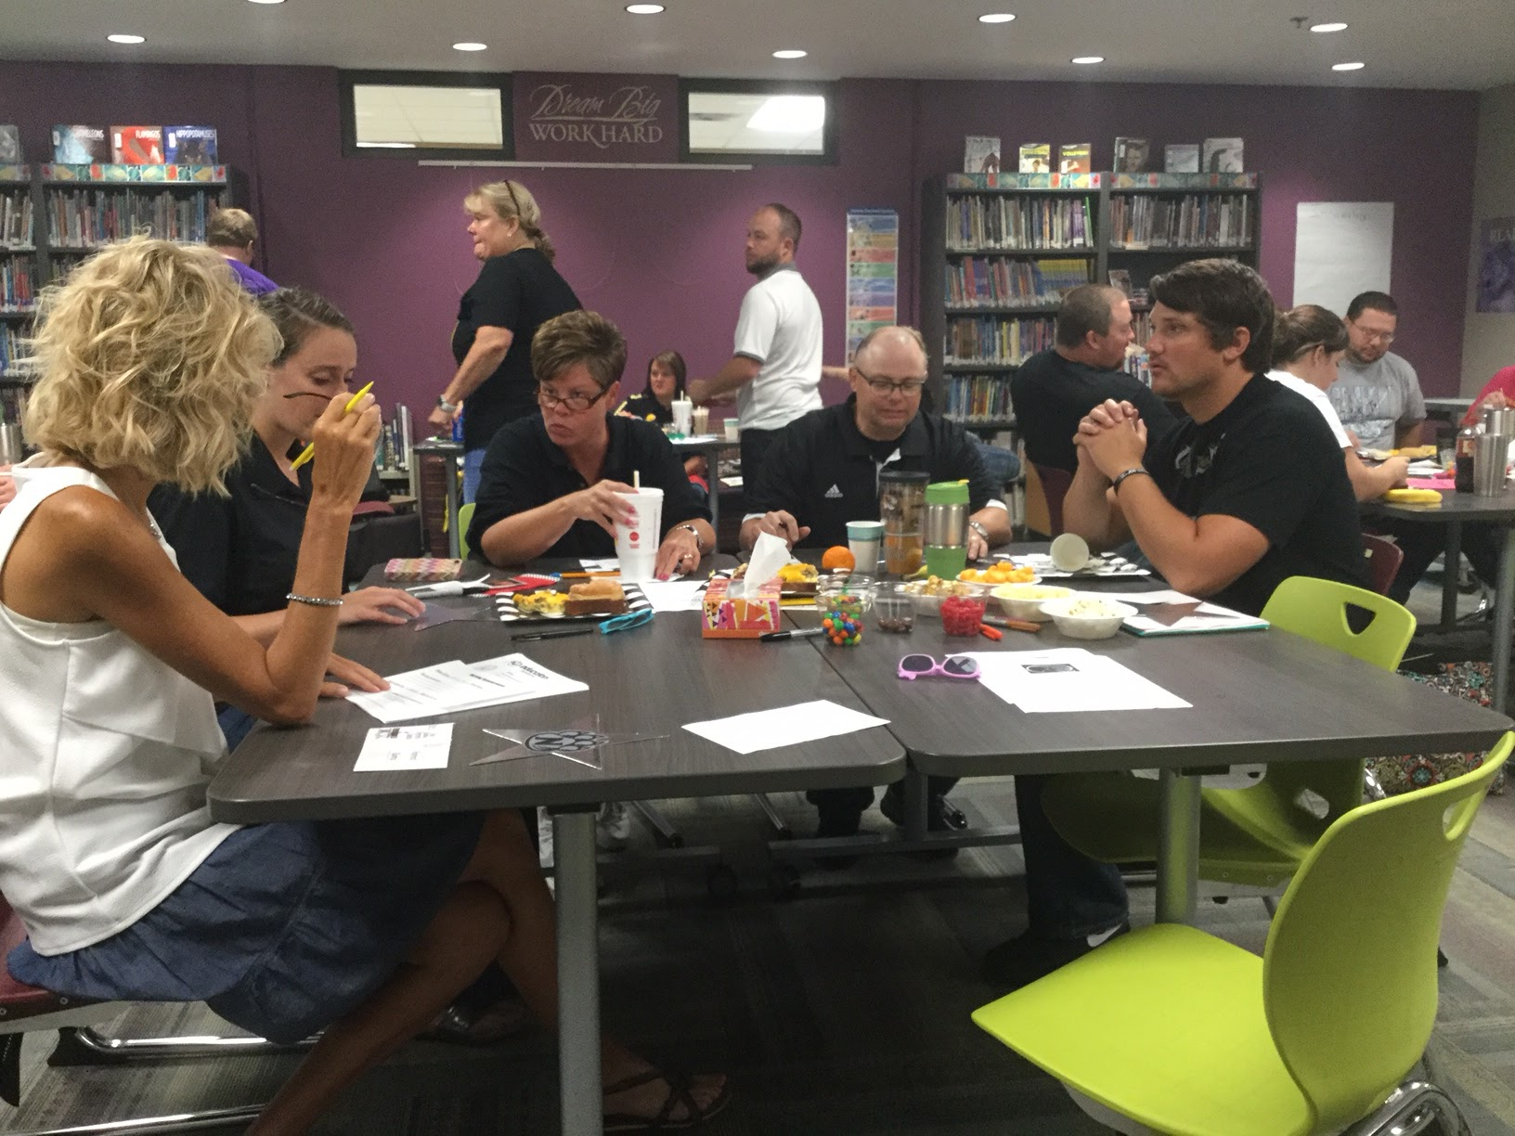
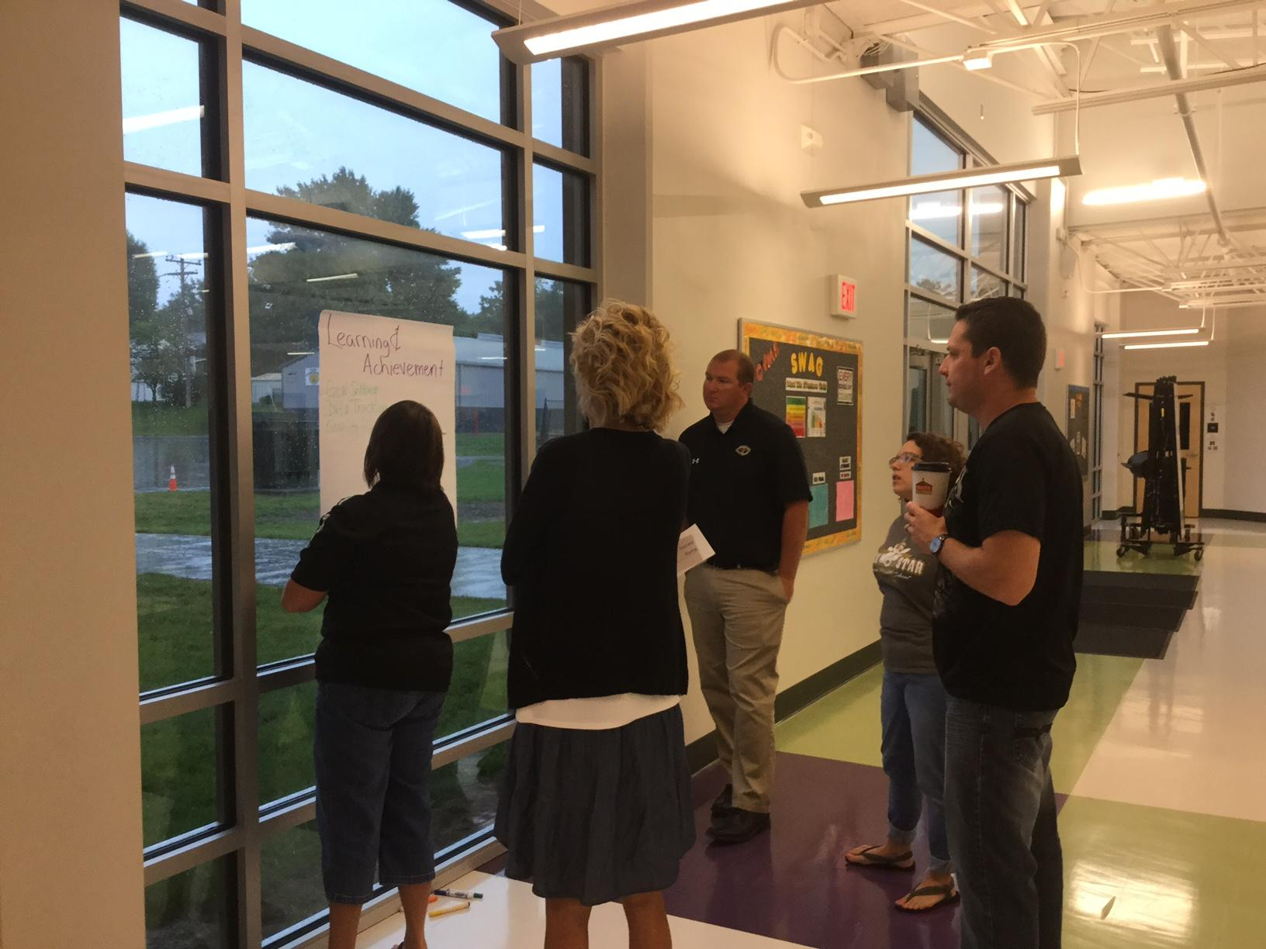
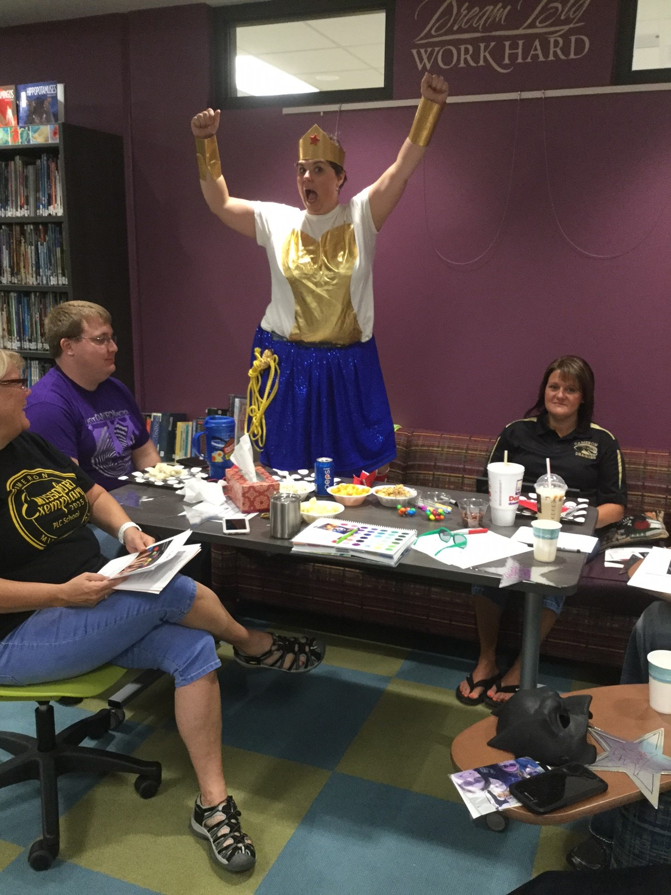
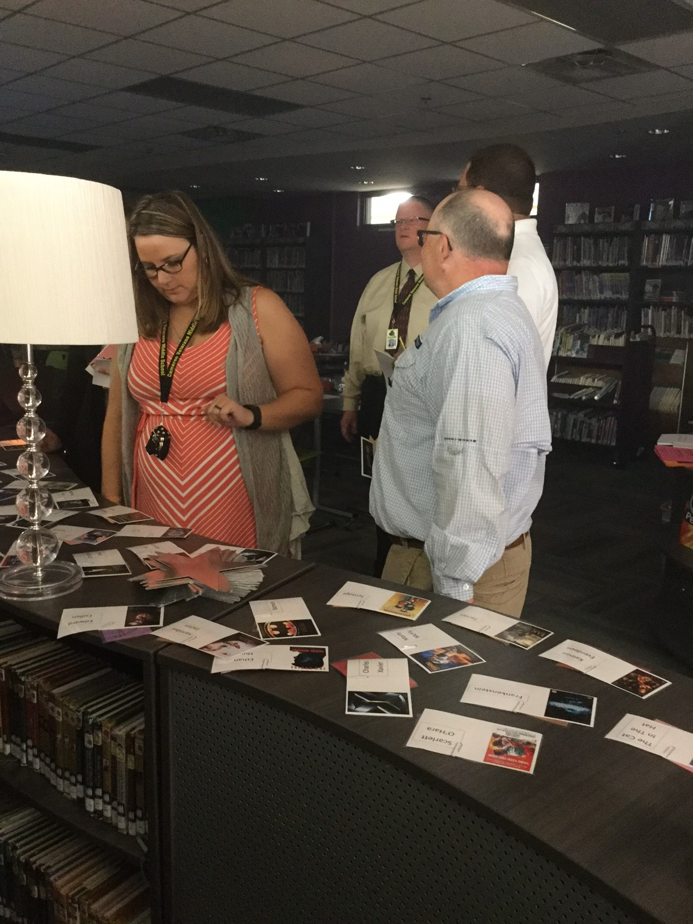
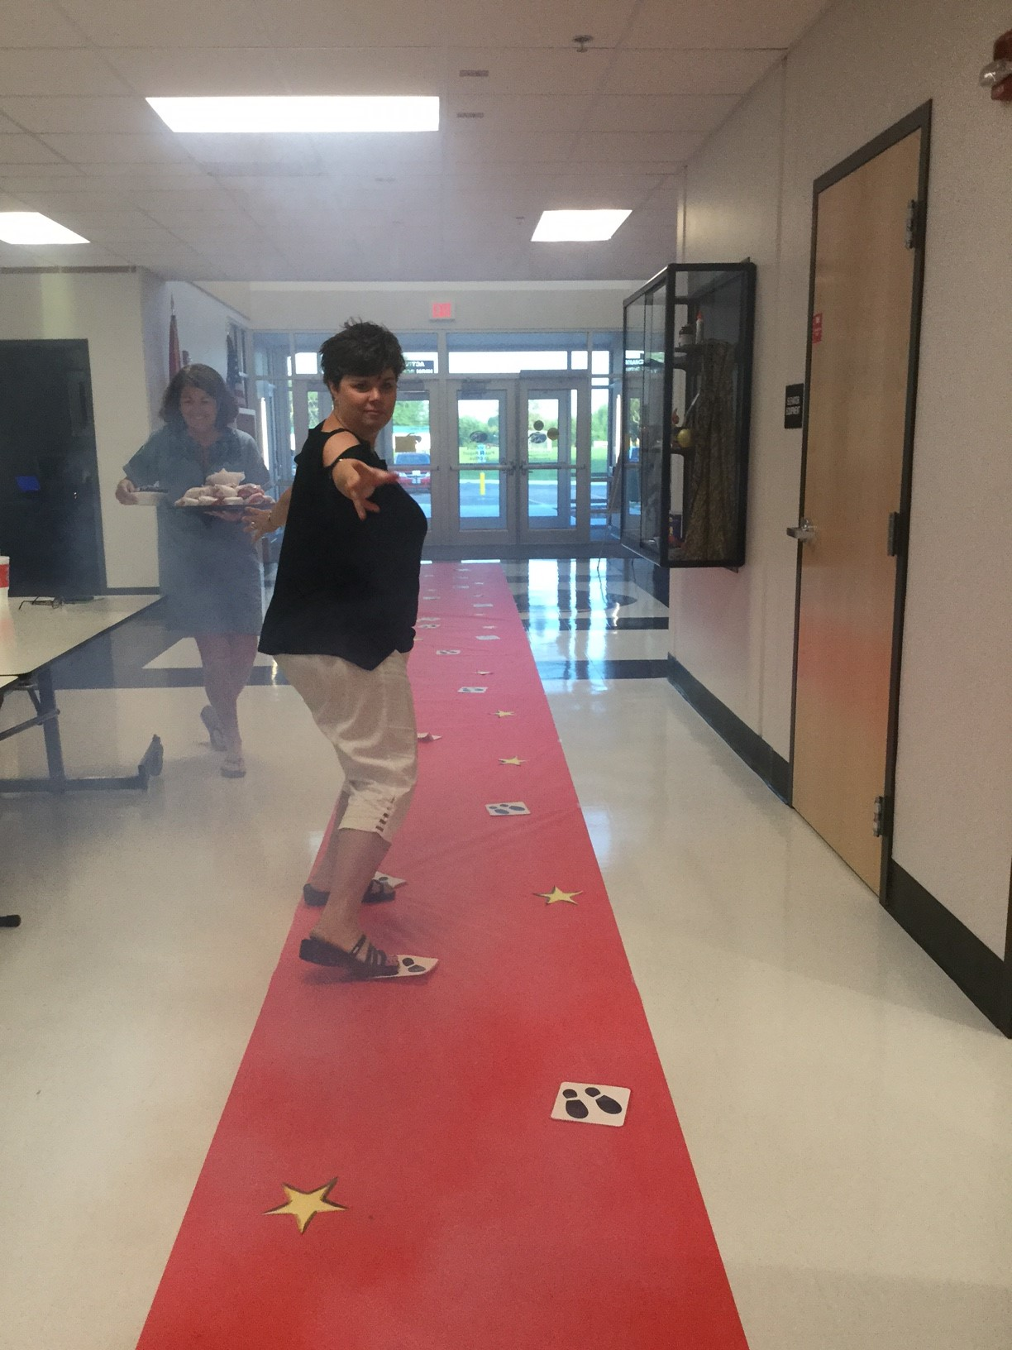
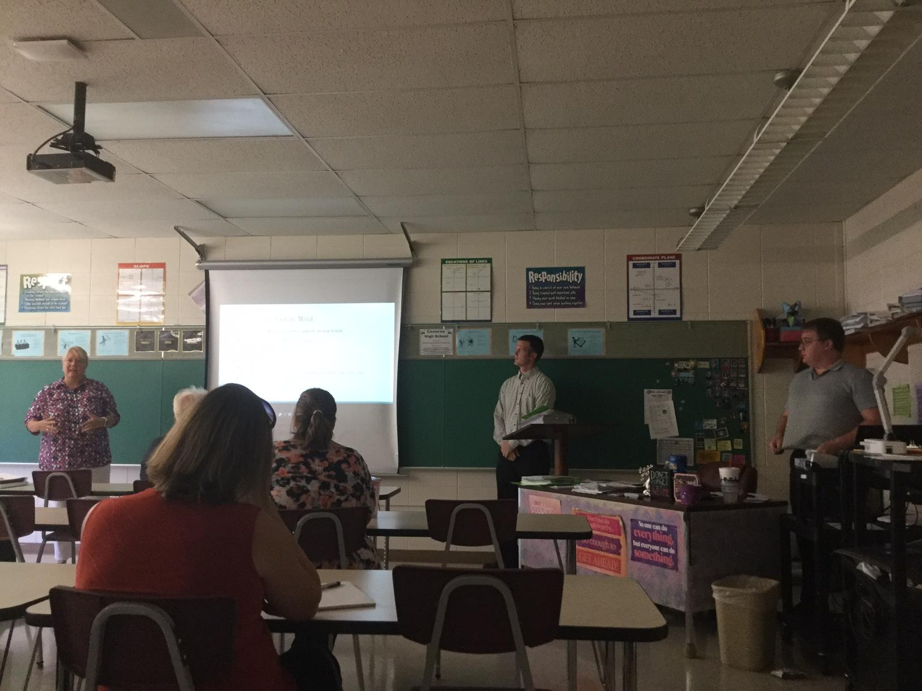
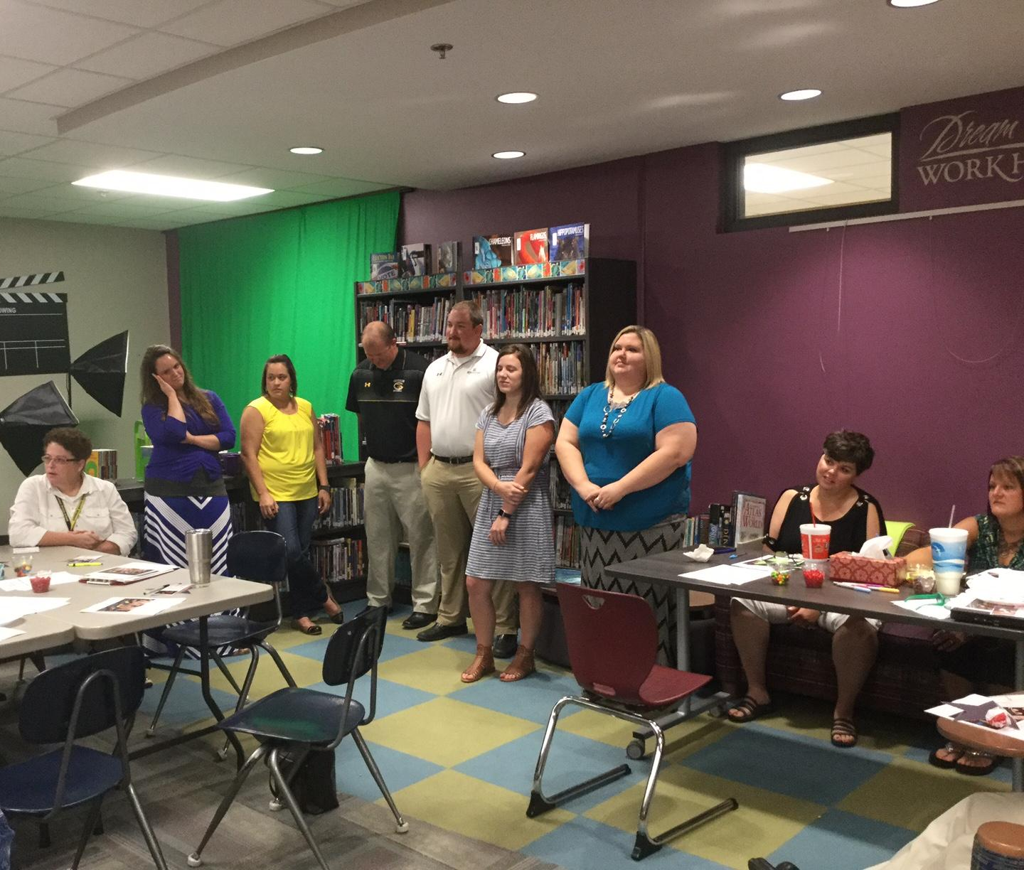
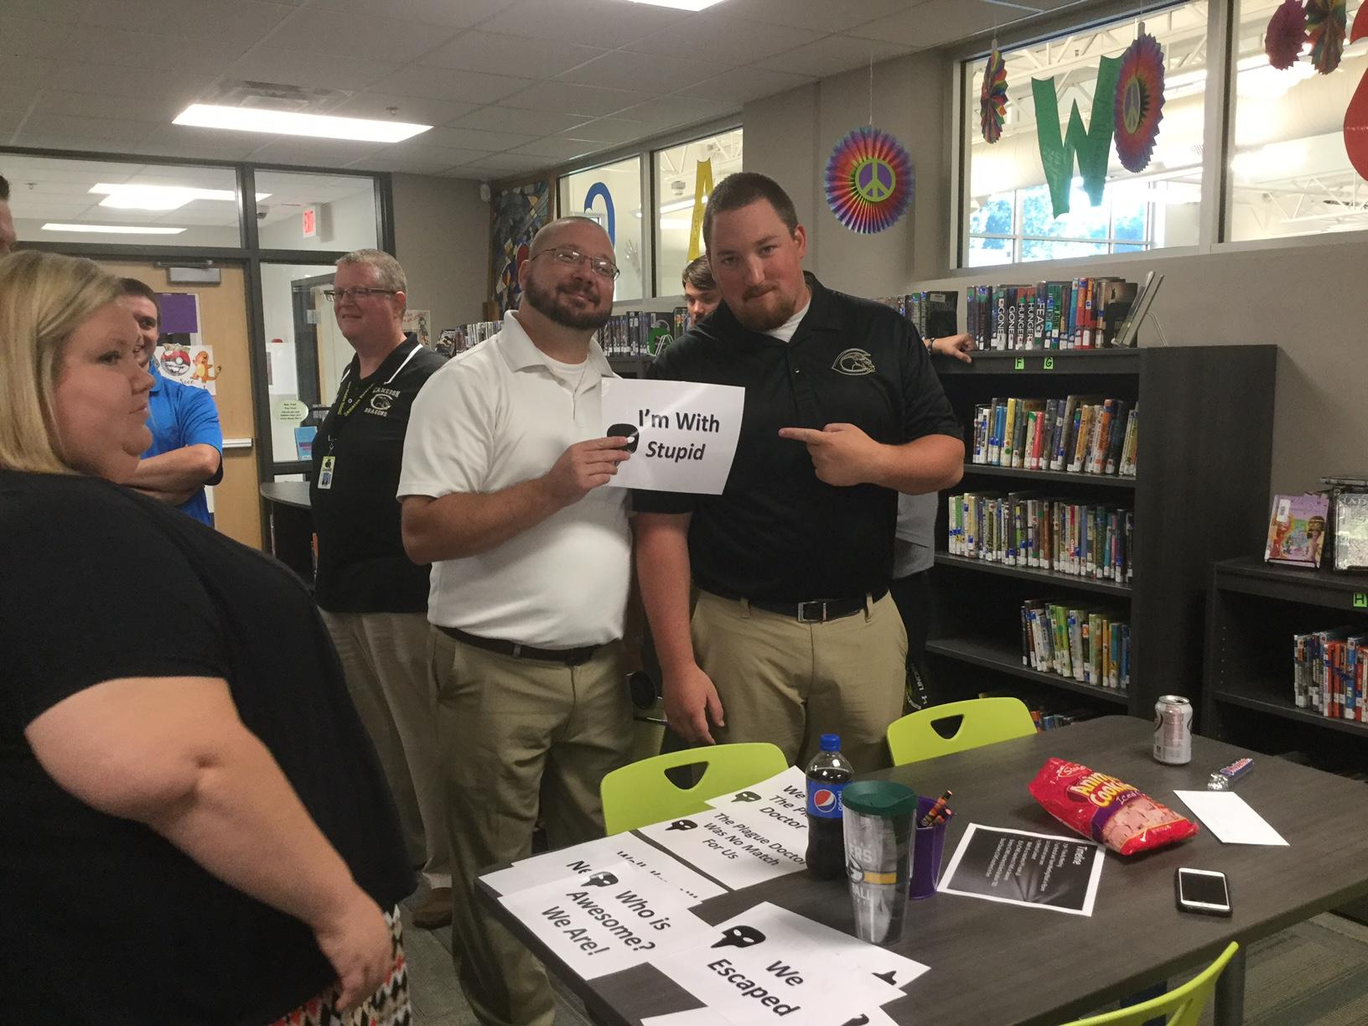
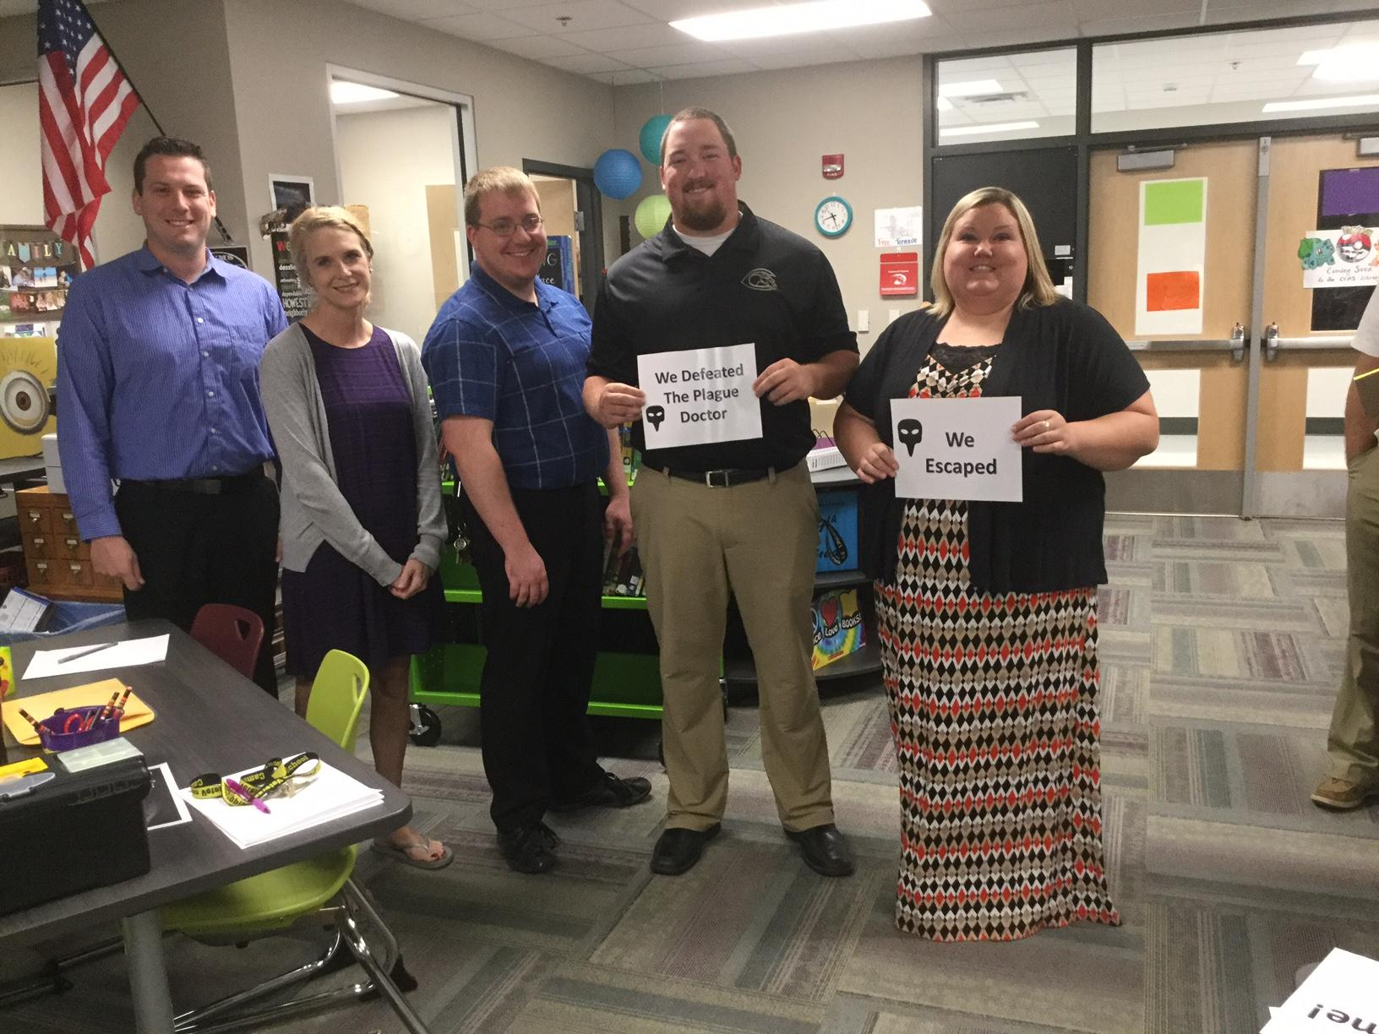
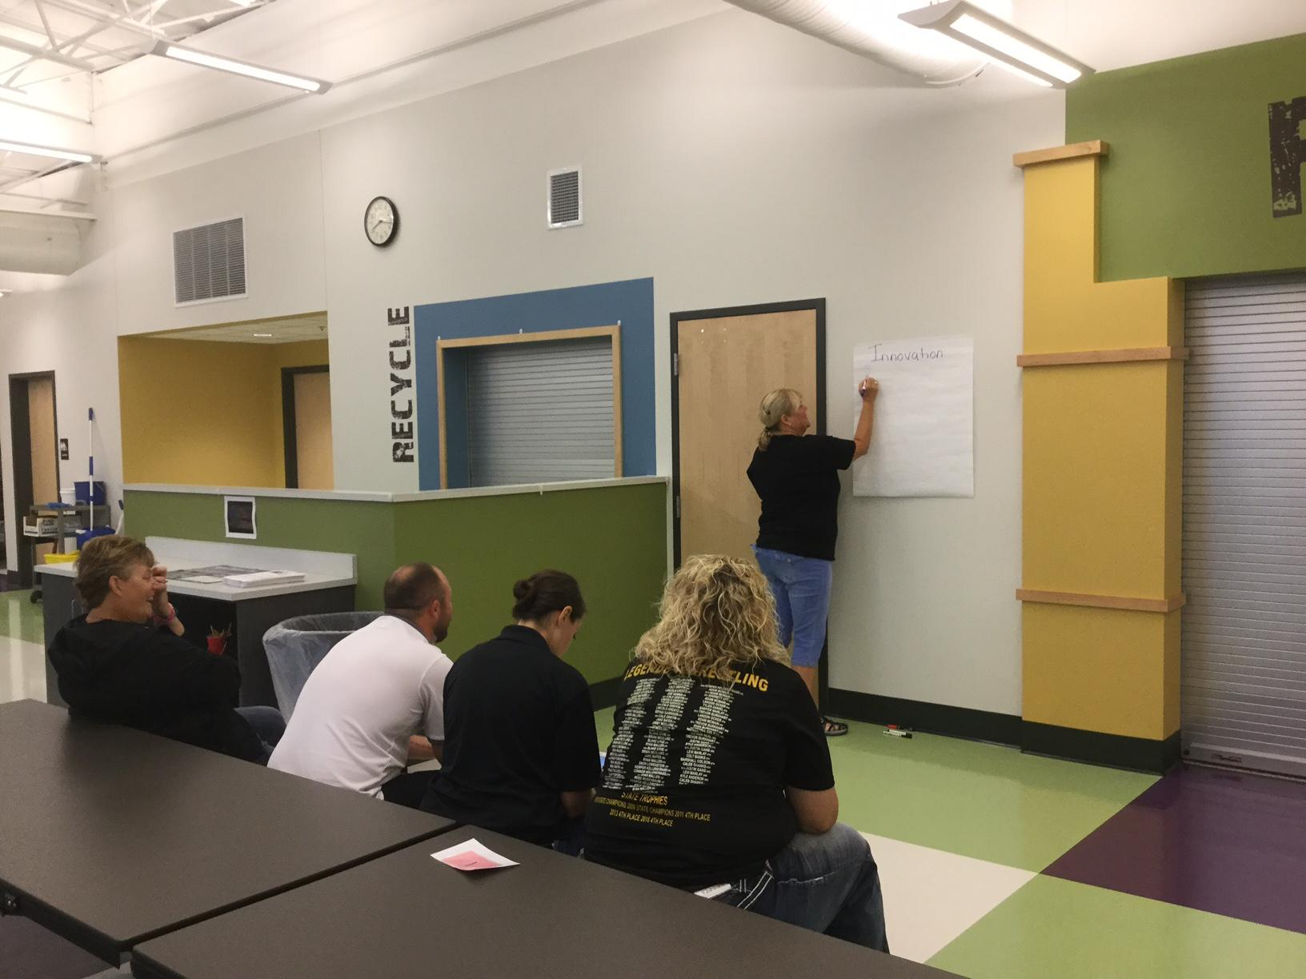
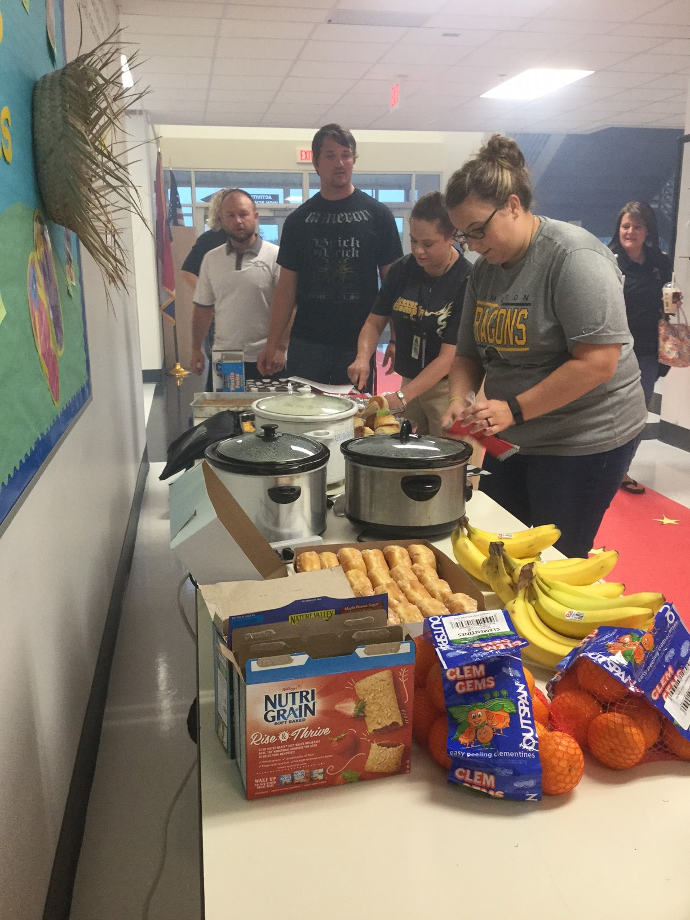
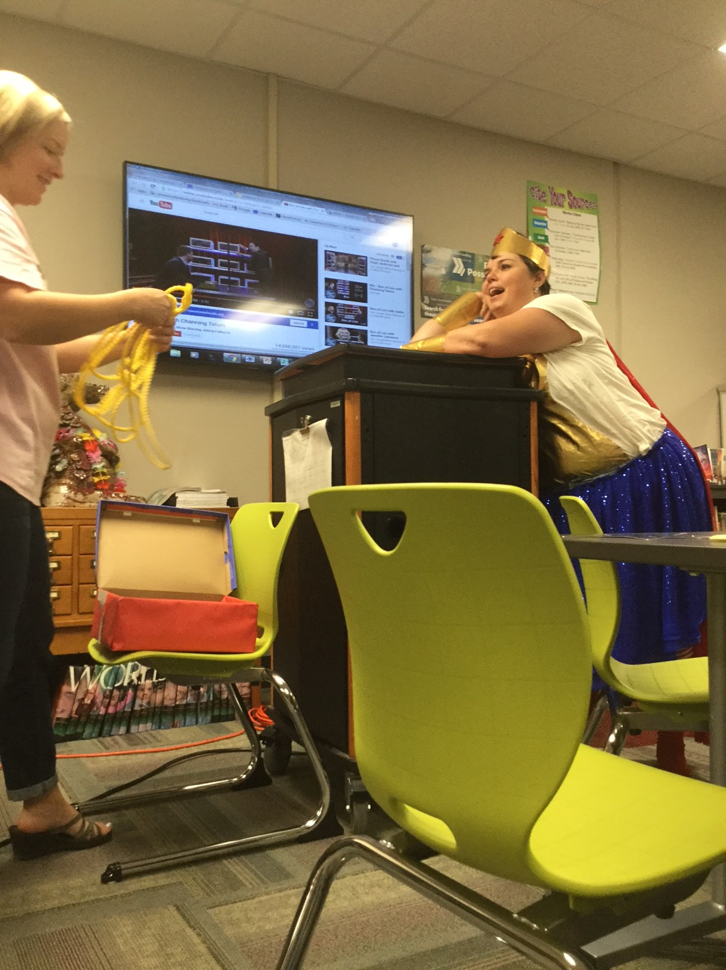
Financial-
Collaborative Culture
http://cameronleaders.weebly.com/
Vision
Mission
Values
Goals
Notes:
Tiffani and Lesa
District Objective: The Cameron R‐1 School District will recruit and retain high quality teachers.
BOE Approved Strategy: All professional staff (including paraprofessionals and administrators) will participate in professional development to ensure their personal professional growth to increase student achievement - PDC.
9.2
-Team building (escape classroom, box of lies) and school culture (monthly PD, weekly and daily team meetings, and TLIM provides common language)
-Other ways we celebrate each other:
high fives
birthdays
staff shirts
staff dinner at my house
breakfast provided at first day PD
pat on the back in the DD
several catered meals throughout the year that are donated to CVMS
Team meetings-reflection days

Slide 17
Financial-
Professional Development
In-House
Out-of-House
Focus of the trainings
Notes:
Tiffani and Lesa
District Objective: The Cameron R‐1 School District will recruit and retain high quality teachers.
BOE Approved Strategy: All professional staff (including paraprofessionals and administrators) will participate in professional development to ensure their personal professional growth to increase student achievement - PDC.
PD
-PDU, NWRPDC, Book studies (SBG and TLIM...both meet weekly during team plan), Principal led
-DESE updates, Missouri Learning Standards alignment, curriculum, Professional Learning Communities
-In house trainings come from Leadership Team, Standards Reference Grading Team, Collins and other teams (as needed)
-Update on “Exemplary status

Slide 18
Climate
Book Study
Counselor Meetings
Bullying forms
Notes:
Angela and Ann
District Objective:
The Cameron R‐1 School District will look into and develop anti‐bullying programs
BOE Approved Strategy: Implementation of The Leader in Me program

Slide 19
Book Study
Notes:
AGC - Each student gets a quarter of instruction in Steven Covey’s ‘Seven Habits of Highly Effective Teens’
Teachers are doing a weekly, semester-long book study. This conversation is another step in fulfilling our collective commitment to apply the Seven Habits in our work with students and with each other. The teachers are doing ‘The Leader in Me’ as a book study - students using ‘SHHET’ It is a process, not a program! (Operating System)

Slide 20
Counselor
Classroom guidance lessons
(Identify, React, Report, Help)
Small groups (student needs)
Bullying Incident Report Form

Slide 21
Communication
Teachers, Parents, Students & Admin.
Grade level team meeting
Bi-weekly Administration Meeting
Vertical content team meetings
Faculty Meeting
A+
Notes:
Webber and Wernimont
McDaniel is doing A+

Slide 22
Questions??
Notes:
Tiffani Ask now or email later

Slide 23
Thank You

